Slide 1

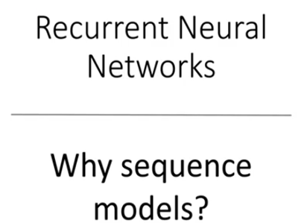
Copyright © www.ITbodhi.com
Notes:
Recurrent NN: Very successful in Speech Recognition and NLP
But it is also important that you understand what sequential data is. It basically is just ordered data, where related things follow each other. Examples are financial data or the DNA sequence. The most popular type of sequential data is perhaps Time series data, which is just a series of data points that are listed in time order.

Slide 2
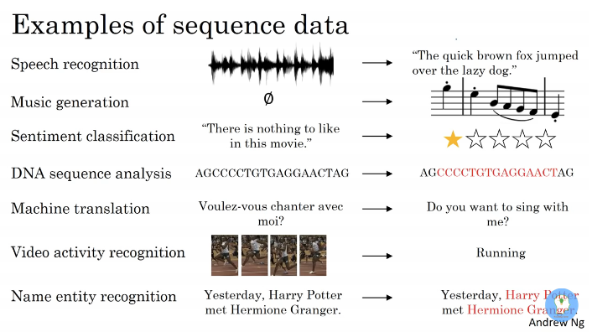
Copyright © www.ITbodhi.com
Notes:
RNN’s are relatively old, like many other deep learning algorithms. They were initially created in the 1980’s, but can only show their real potential since a few years, because of the increase in available computational power, the massive amounts of data that we have nowadays and the invention of LSTM in the 1990’s.

Slide 3
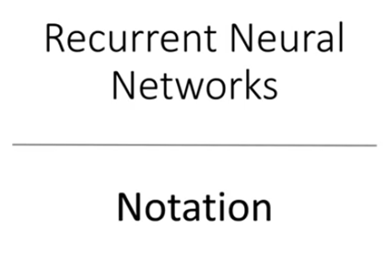
Copyright © www.ITbodhi.com
Notes:
Feed Forward networks:
RNN’s and Feed-Forward Neural Networks are both named after the way they channel information.
In a Feed-Forward neural network, the information only moves in one direction, from the input layer, through the hidden layers, to the output layer. The information moves straight through the network. Because of that, the information never touches a node twice.
Feed-Forward Neural Networks, have no memory of the input they received previously and are therefore bad in predicting what’s coming next. Because a feedforward network only considers the current input, it has no notion of order in time. They simply can’t remember anything about what happened in the past, except their training.
Recurrent Neural Networks
In a RNN, the information cycles through a loop. When it makes a decision, it takes into consideration the current input and also what it has learned from the inputs it received previously.

Slide 4
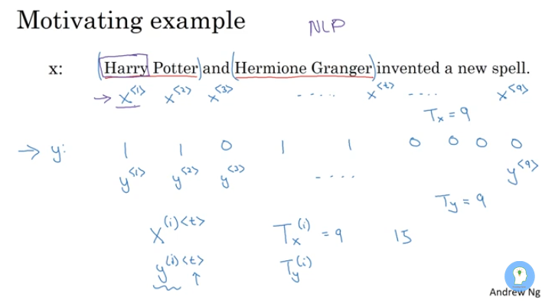
Copyright © www.ITbodhi.com
Notes:
Name entity recognition example: Input X has 9 words and output Y has 9 words.

Slide 5
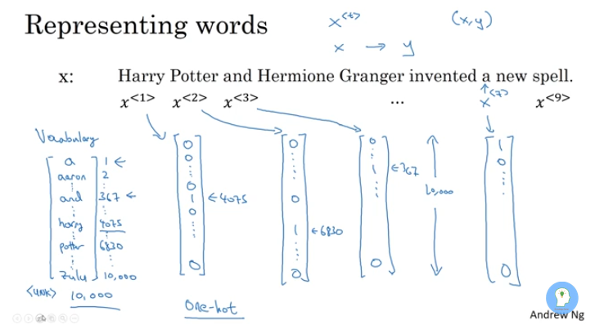
Copyright © www.ITbodhi.com

Slide 6
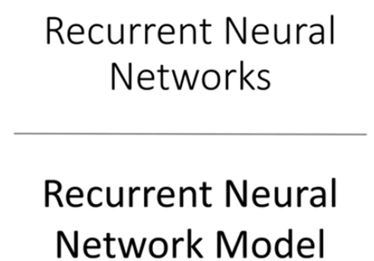
Copyright © www.ITbodhi.com

Slide 7
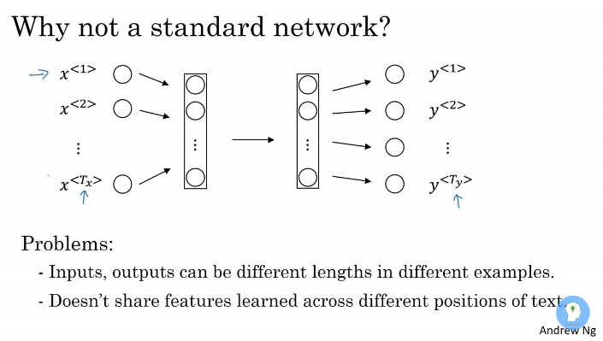
Copyright © www.ITbodhi.com
Notes:
Input test sentence of varying legnth and so as output
If one feature is earned as name then it would not transfer this knowledge to another feature if it is name also.
Very large input due to hot padding of words

Slide 8
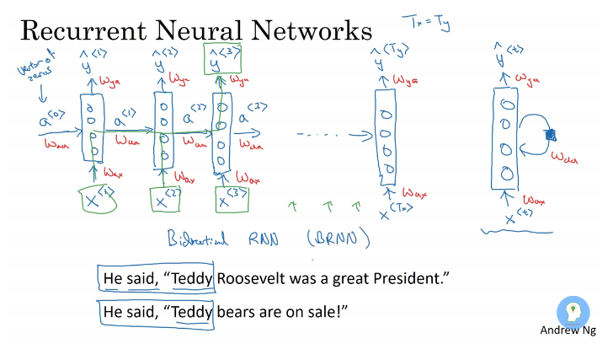
Notes:
Weight of each layers are shared and would be same for each layer
Wax parameter learned would be same for all layers
Waa parameter learned would be same for all layers
Wya parameter learned would be same for all layers
Unidirectional Information forwarding:- Left to right
In given example it is difficult to predict Teddy is a name or not only basis of earlier words but also depends on the following words.
Sentence of different length:
1. do padding with 0
2. Do masking
3. Since that dimension can be None, i.e. variable length. Within a single batch, you must have the same number of timesteps since it must be a tensor (this is typically where you see 0-padding). But between batches there is no such restriction. During inference, you can have any length.
model.add(LSTM(32, return_sequences=True, input_shape=(None, 5)))
4. Supposed you have 10,000 sentences (if you have fewer, then you probably don't need to worry that much about minibatch training). Since each of your sentences is no longer than 100 words, if I assume a normal distribution of length with mean 50, then many of your sentences would share the same length. This observation allows you to simply make minibatches of sentences of the same length.
The advantage of doing so is that you don't need to worry about masking or adding zero tokens. In my implementations, doing so simplifies the operations on updating word embeddings, computing gradients, etc. by a great deal.
A little issue is that most of your minibatches will be fine (i.e. have the minibatch size you want), except for a few smaller ones. If you have sufficient data to live a lavish life, then just throw these smaller batches away. If you don't want that, then note that training RNNs on different mininbatch size would require some techniques, such as normalizing the learning rate by the minibatch size, appropriate gradient clipping, or more advance ones such as batch normalization. But all of them are just a breeze to implement.
Zero-padding
X = keras.preprocessing.sequence.pad_sequences(sequences, maxlen=100)
model.fit(X, y, batch_size=32, nb_epoch=10)
Batches of size 1
for seq, label in zip(sequences, y):
model.train(np.array([seq]), [label])

Slide 9
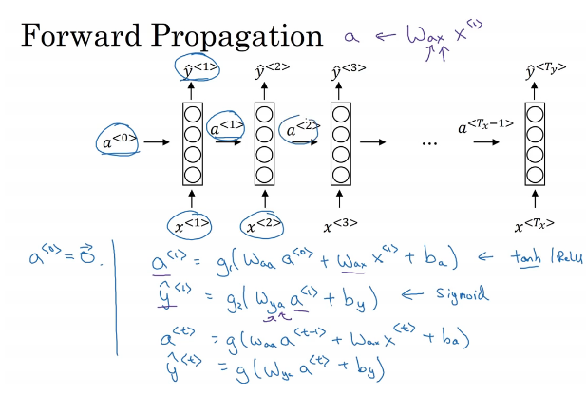
Copyright © www.ITbodhi.com

Slide 10
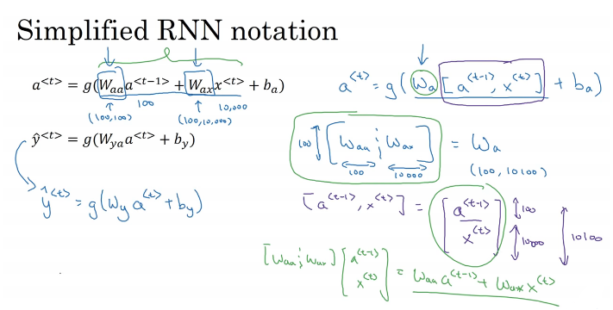
Copyright © www.ITbodhi.com

Slide 11
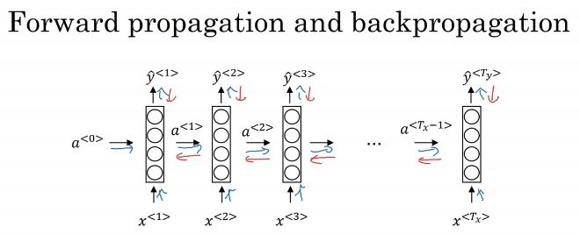
Copyright © www.ITbodhi.com

Slide 12
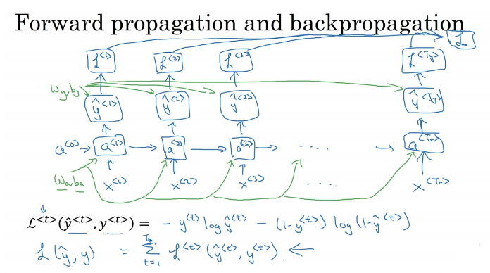
Copyright © www.ITbodhi.com

Slide 13
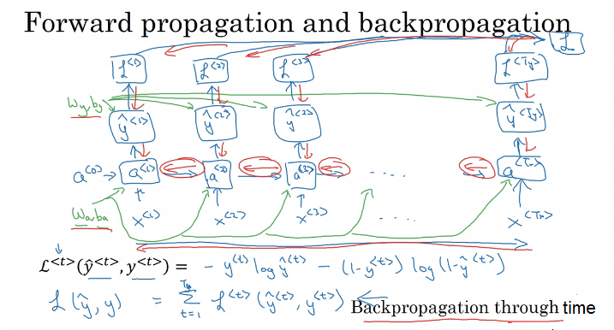
Copyright © www.ITbodhi.com

Slide 14
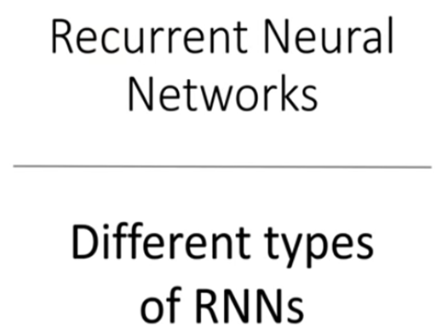
Copyright © www.ITbodhi.com

Slide 15
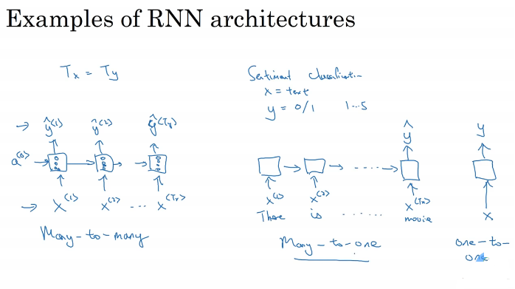
Copyright © www.ITbodhi.com

Slide 16
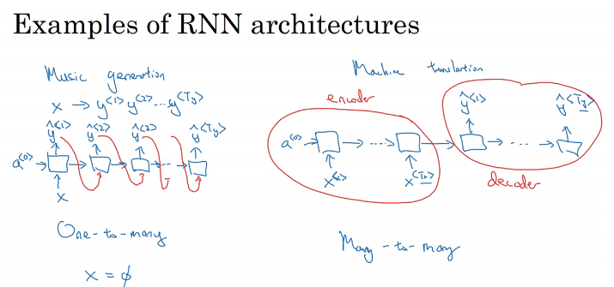
Copyright © www.ITbodhi.com

Slide 17
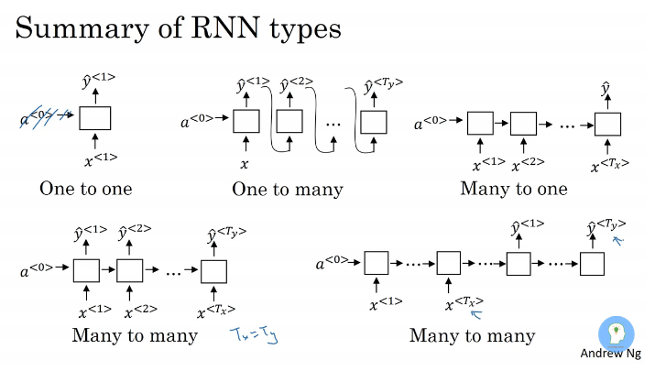
Copyright © www.ITbodhi.com

Slide 18
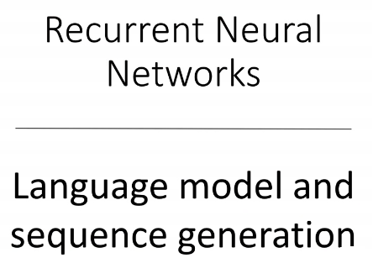
Copyright © www.ITbodhi.com

Slide 19
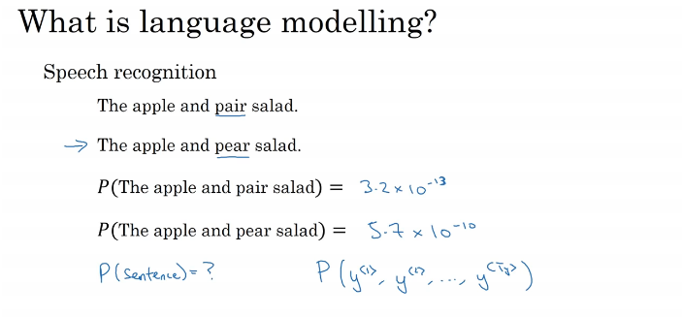
Copyright © www.ITbodhi.com
Notes:
The goal of a language model is to compute a probability of a token (e.g. a sentence or a sequence of words).
Language Model (LM) actually a grammar of a language as it gives the probability of word that will follow.
To complete the NLP tasks we must provide a measure to enable comparison operations and thus assessment method for grading our model. This measure is probability. This involves all kinds of tasks, for example:
Machine translation: translating a sentence saying about height it would probably state that P(tall man)>P(large man)
as the ‘large’ might also refer to weight or general appearance thus, not as probable as ‘tall’
Spelling Correction: Spell correcting sentence: “Put you name into form”, so that P(name into form)>P(name into from)
Speech Recognition: Call my nurse: P(Call my nurse.)≫P(coal miners)
, I have no idea. P(no idea.)≫P(No eye deer.)
Summarization, question answering, sentiment analysis etc.
Model calculates the probability of the predictive sentence.
Speech Recognition and Language translation

Slide 20
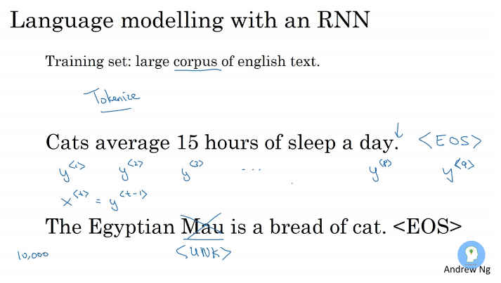
Copyright © www.ITbodhi.com
Notes:
First tokenize the sentence using one hot, one gram etc.
All Words which are not in dictonary are mapped to <unkown token>
10,000 output softmax function

Slide 21
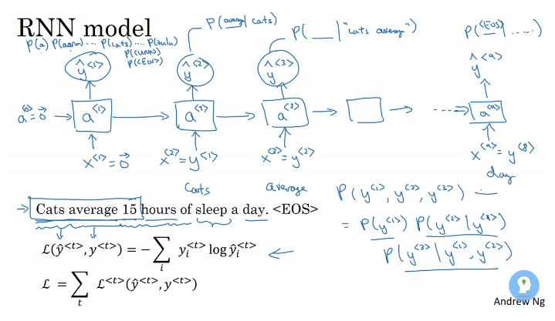
Copyright © www.ITbodhi.com
Notes:
For testing word y1 y2 y3 it will calculate the P(y1) p(y2) p(y3) and probability of sentence P(y1)*p(y2)*p(y3)

Slide 22
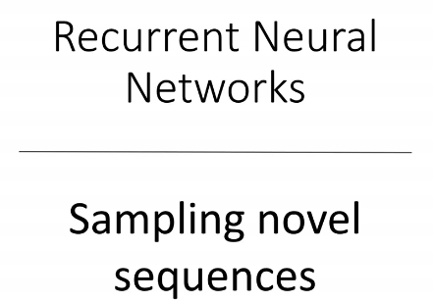
Copyright © www.ITbodhi.com

Slide 23
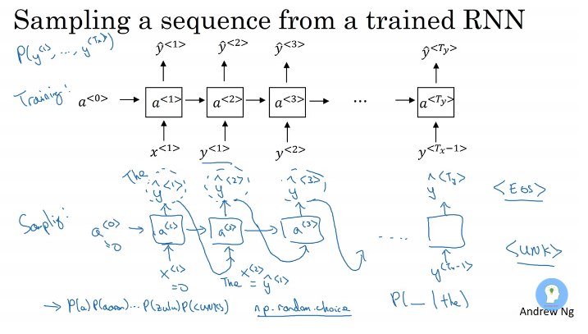
Copyright © www.ITbodhi.com
Notes:
Independent layer in output for each layer in input

Slide 24
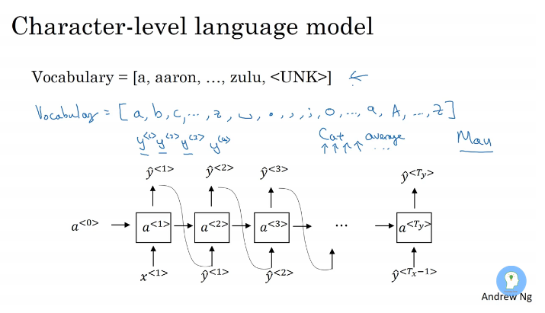
Copyright © www.ITbodhi.com
Notes:
Computationally expensive
Not as good as word language model to capture long range dependency.
Very few special cases

Slide 25
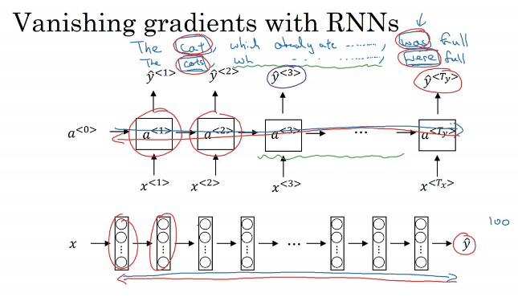
Copyright © www.ITbodhi.com
Notes:
Problem with basic RNN and not able to capture long range dependencies.
Exploding gradients: Gradient clipping

Slide 26
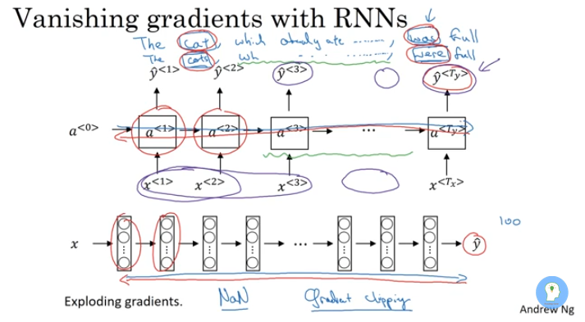
Copyright © www.ITbodhi.com
Notes:
Independent layer in output for each layer in input

Slide 27
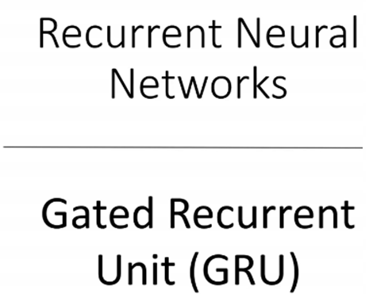
Copyright © www.ITbodhi.com

Slide 28
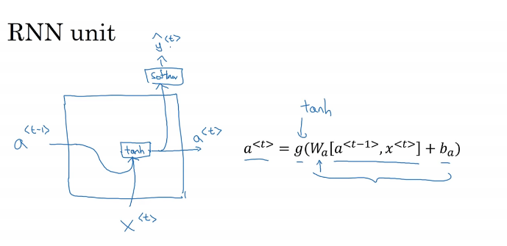
Copyright © www.ITbodhi.com

Slide 29
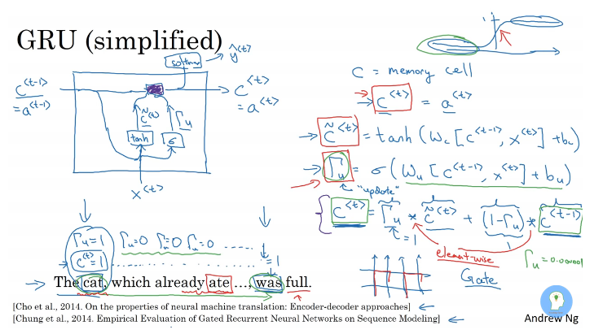
Copyright © www.ITbodhi.com
Notes:
Cell value is preserved to last value using sigmoid function even if there are long layers.
Reduces gradient diminish problem.
Cell is 100 dimension vector( if there are 100 neuron at layer) so each bit would be learning like gender, plural/singular etc.

Slide 30
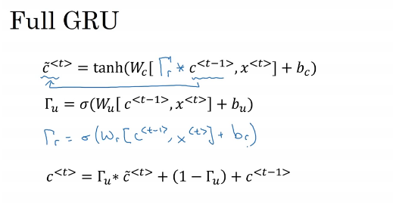
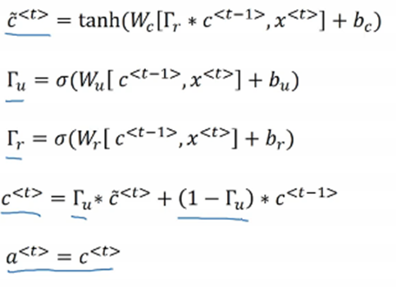
Copyright © www.ITbodhi.com
Notes:
New gate is added to find out how much C<t-1> value is relevant to update c<t>

Slide 31
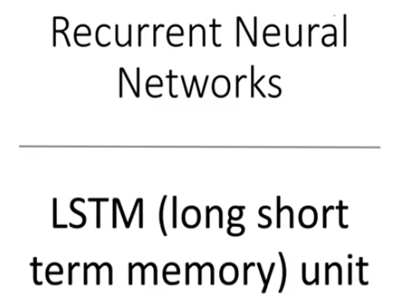
Copyright © www.ITbodhi.com
Notes:
More powerful than GRU

Slide 32
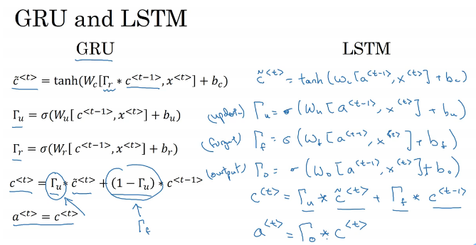
Copyright © www.ITbodhi.com
Notes:
Independent layer in output for each layer in input

Slide 33
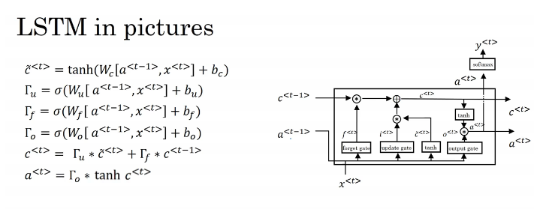
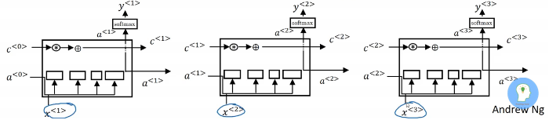
Copyright © www.ITbodhi.com
Notes:
Independent layer in output for each layer in input

Slide 34
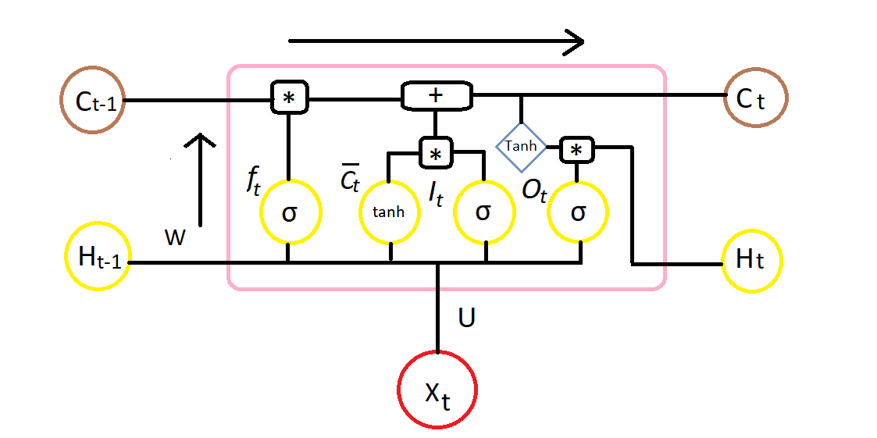
Copyright © www.ITbodhi.com
Notes:
Independent layer in output for each layer in input

Slide 35
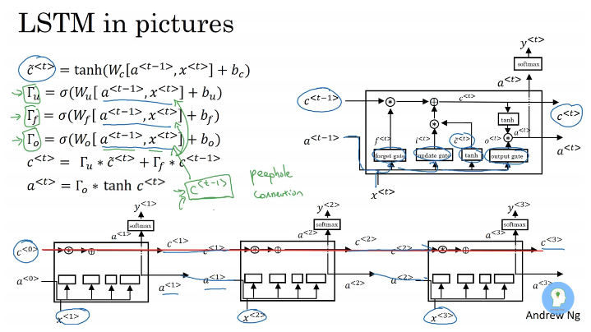
Copyright © www.ITbodhi.com
Notes:
Peephole LSTM : where C<t-1> also used to calculate values of gates
LSTM is earlier and GRU came as simplified version of LSTM
GRU run much faster due to simplicity and can be scaled up for bigger problem but LSTM is more powerful and flexible and majorly used.
LSTM founded earlier than GRU.

Slide 36
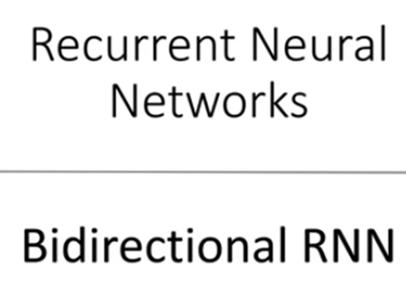
Copyright © www.ITbodhi.com
Notes:
Independent layer in output for each layer in input.
Its function is to progressively reduce the spatial size of the representation to reduce the amount of parameters and computation in the network, and hence to also control overfitting. The Pooling Layer operates independently on every depth slice of the input and resizes it spatially, using the MAX operation

Slide 37
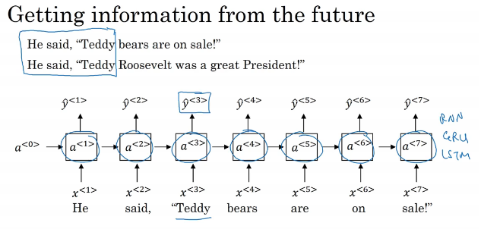
Copyright © www.ITbodhi.com

Slide 38
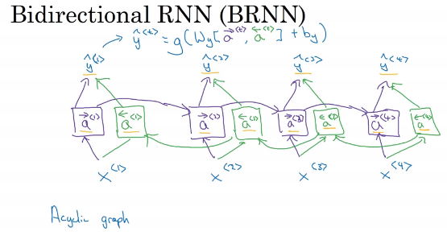
Copyright © www.ITbodhi.com
Notes:
Need complete sentence data at once.
Limitation: Need entire sentence at a time to make prediction

Slide 39
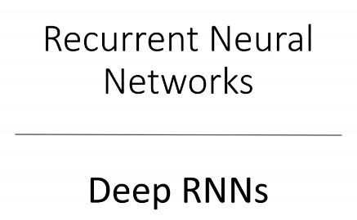
Copyright © www.ITbodhi.com
Notes:
Need complete sentence data at once.

Slide 40
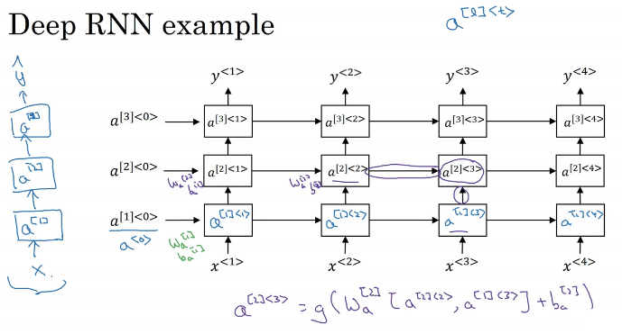
Copyright © www.ITbodhi.com
Notes:
Need complete sentence data at once.

Slide 41
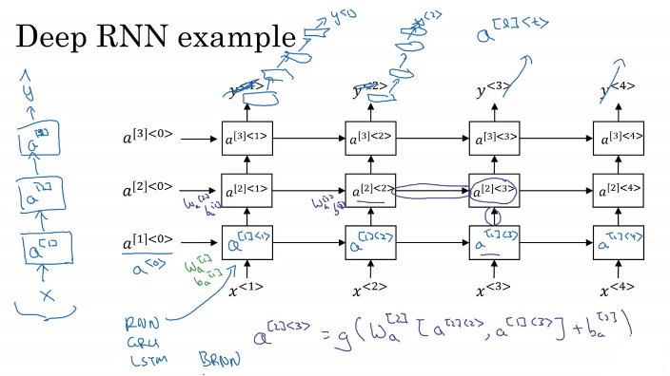
Copyright © www.ITbodhi.com
Notes:
Make deep layer vertically which are not horizontally connected.

